Slide 1
IT694 Computer Networks Week11_Lec 2
OSPF and BGP

Slide 2
Hierarchical OSPF
two-level hierarchy: local area, backbone.
link-state advertisements flooded only in area, or backbone
each node has detailed area topology; only knows direction to reach other destinations
area border routers: “summarize” distances to destinations in own area, advertise in backbone
boundary router: connects to other ASes
backbone
backbone router: runs OSPF limited to backbone
local routers:
flood LS in area only
compute routing within area
forward packets to outside via area border router
area 3
internal
routers
area 1
area 2

Slide 3
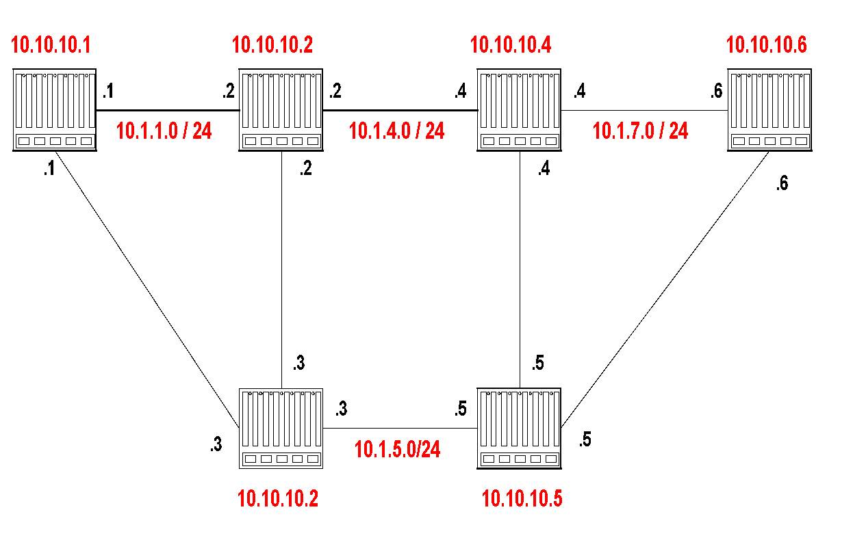
Example Network
Router IDs are selected independent of interface addresses
Link costs are called Metric
Metric is in the range [0 , 2¹⁶]
Metric can be asymmetric

Slide 4
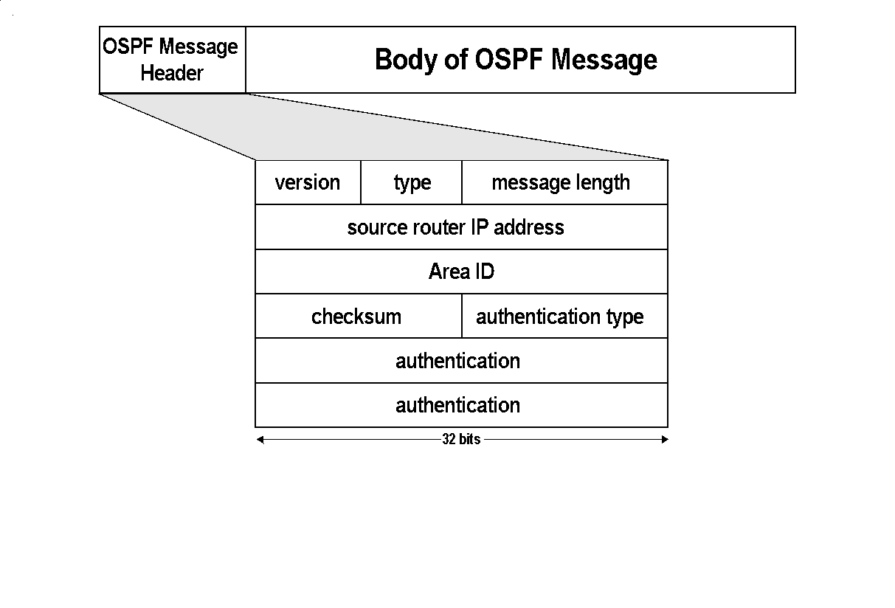
Message types:
1: Hello (tests reachability)
2: Database description
3: Link Status request
4: Link state update
5: Link state acknowledgement

Slide 5
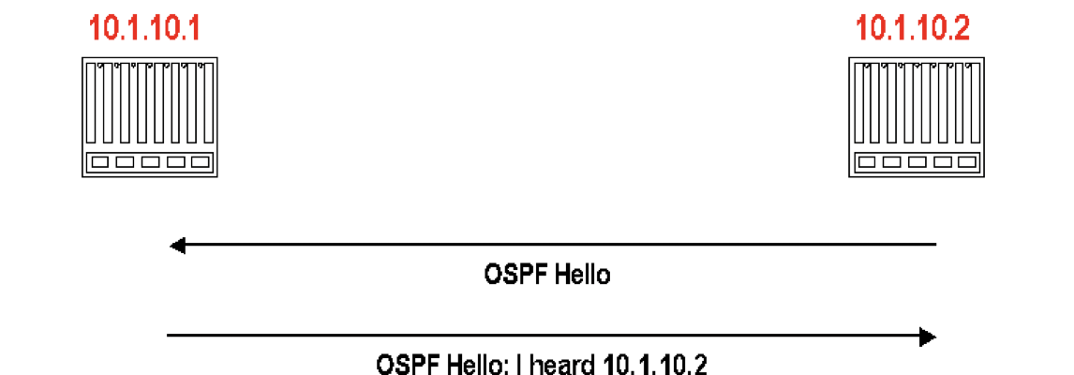
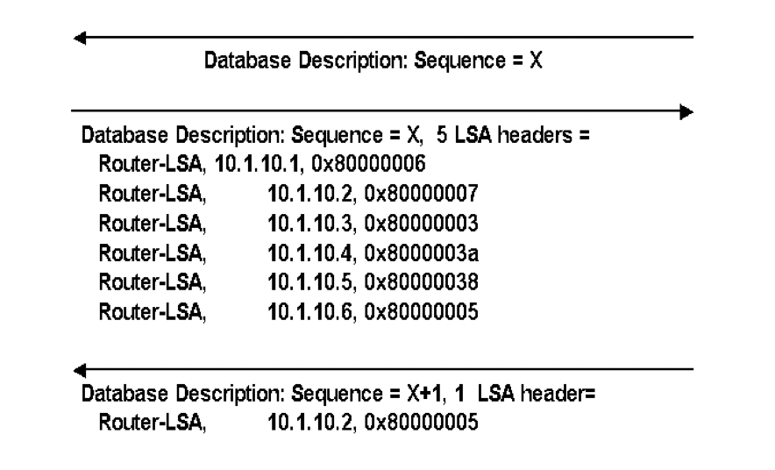

Discovery of adjacency – HELLO MESSAGES
After neighbors are discovered the nodes exchange their databases
Sends database description. (description only contains LSA headers)
Database description of 10.1.10.2
Acknowledges receipt of description
Routers multicasts OSPF Hello packets on all OSPF-enabled interfaces.
If two routers share a link, they can become neighbors, and establish an adjacency
After becoming a neighbor, routers exchange their link state databases

Slide 6
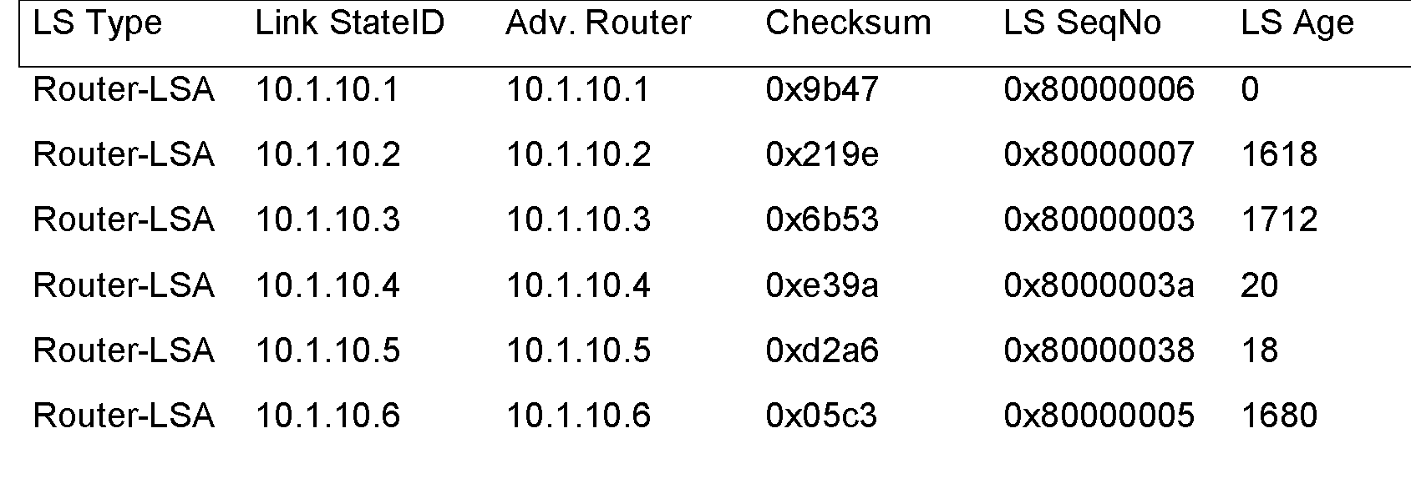
Link State Database
The collection of all LSAs is called the link-state database
Each router has an identical link-state database
Useful for debugging: Each router has a complete description of the network
If neighboring routers discover each other for the first time, they will exchange their link-state databases
The link-state databases are synchronized using reliable flooding

Slide 7

Interconnected ASes
intra-AS
routing
3c
3a
inter-AS routing
2c
3b
2a
intra-AS
routing
1c
2b
AS3
intra-AS
routing
1a
1b
AS2
1d
AS1
intra-AS (aka “intra-domain”): routing among routers within same AS (“network”)
inter-AS (aka “inter-domain”): routing among AS’es
Notes:
Each router then locally runs Dijkstra’s shortest-path algorithm to determine a shortest-path tree to all subnets, with itself as the root node.

Slide 8

Inter-AS routing: a role in intradomain forwarding
suppose router in AS1 receives datagram destined outside of AS1:
AS1 inter-domain routing must:
learn which destinations reachable through AS2, which through AS3
propagate this reachability info to all routers in AS1
router should forward packet to gateway router in AS1, but which one?
3c
3a
2c
other
networks
3b
2a
1c
2b
AS3
other
networks
1a
1b
AS2
1d
AS1

Slide 9
Inter-AS routing: BGP
BGP (Border Gateway Protocol): the de facto inter-domain routing protocol
“glue that holds the Internet together”
Subnets
Advertise its existence
Destinations it can reach, to rest of Internet
BGP provides each AS a means to:
obtain → destination network reachability info from neighboring ASes (eBGP)
Determine→ routes to other networks based on reachability information and policy
propagate → reachability information to all AS-internal routers (iBGP)
advertise → (to neighboring networks) destination reachability info
Notes:
Since an inter-AS routing protocol involves coordination among multiple ASs, communicating ASs must run the same inter-AS routing protocol. In fact, in the Internet, all ASs run the same inter-AS routing protocol, called the Border Gateway Protocol, more commonly known as BGP

Slide 10
BGP basics
BGP session: two BGP routers (“peers”) exchange BGP messages over semi-permanent TCP connection:
advertising paths to different destination network prefixes (BGP is a “path vector” protocol)
when AS3 gateway 3a advertises path AS3,X to AS2 gateway 2c:
AS3 promises to AS2 it will forward datagrams towards X
AS 3
3b
AS 1
1b
3a
3c
1a
1c
AS 2
3d
2b
1d
2a
2c
BGP advertisement:
AS3, X
X
2d

Slide 11
BGP path advertisement
AS 3
3b
AS 1
1b
3a
3c
1a
1c
AS 2
3d
X
2b
1d
AS3, X
AS2,AS3,X
2a
2c
2d
AS2 router 2c receives path advertisement AS3,X (via eBGP) from AS3 router 3a
based on AS2 policy, AS2 router 2c accepts path AS3,X, propagates (via iBGP) to all AS2 routers
based on AS2 policy, AS2 router 2a advertises (via eBGP) path AS2, AS3, X to AS1 router 1c

Slide 12
eBGP, iBGP connections
2b
∂
2a
2c
1b
3b
2d
∂
1a
1c
3a
3c
AS 2
1d
3d
AS 1
eBGP connectivity
AS 3
logical iBGP connectivity
1c
gateway routers run both eBGP and iBGP protocols

Slide 13
BGP: populating forwarding tables
AS 3
3b
AS 1
1b
AS3,X
3a
3c
1
AS3,X
1a
AS3,X
1c
AS 2
2b
3d
X
local link interfaces
at 1a, 1d
2
AS3,X
2
1d
1
AS3, X
AS2,AS3,X
2a
2c
2d
dest
interface
recall: 1a, 1b, 1d learn via iBGP from 1c: “path to X goes through 1c”
…
…
at 1d: OSPF intra-domain routing: to get to 1c, use interface 1
1c
1
X
1
at 1d: to get to X, use interface 1
…
…

Slide 14
BGP: populating forwarding tables
AS 3
3b
AS 1
1b
3a
3c
1
1a
1c
AS 2
3d
X
2
2b
1d
2a
2c
2d
dest
interface
…
…
recall: 1a, 1b, 1d learn via iBGP from 1c: “path to X goes through 1c”
1c
2
at 1d: OSPF intra-domain routing: to get to 1c, use interface 1
X
2
…
…
at 1d: to get to X, use interface 1
at 1a: OSPF intra-domain routing: to get to 1c, use interface 2
at 1a: to get to X, use interface 2

Slide 15
General Organization of ISPs

Slide 16
Relationship in BGP

